Slide 1

PARENT VISIT
Welcome · by Rochford’s Education
Primary to Secondary · IGCSE · Ipoh
Parent Visit · Ipoh
Notes:
Welcome families to Rochford’s International School, by Rochford’s Education: primary to secondary, IGCSE, in Ipoh.
Sources: our founder; https://edquest.edu.my/pages/about-us

Slide 2
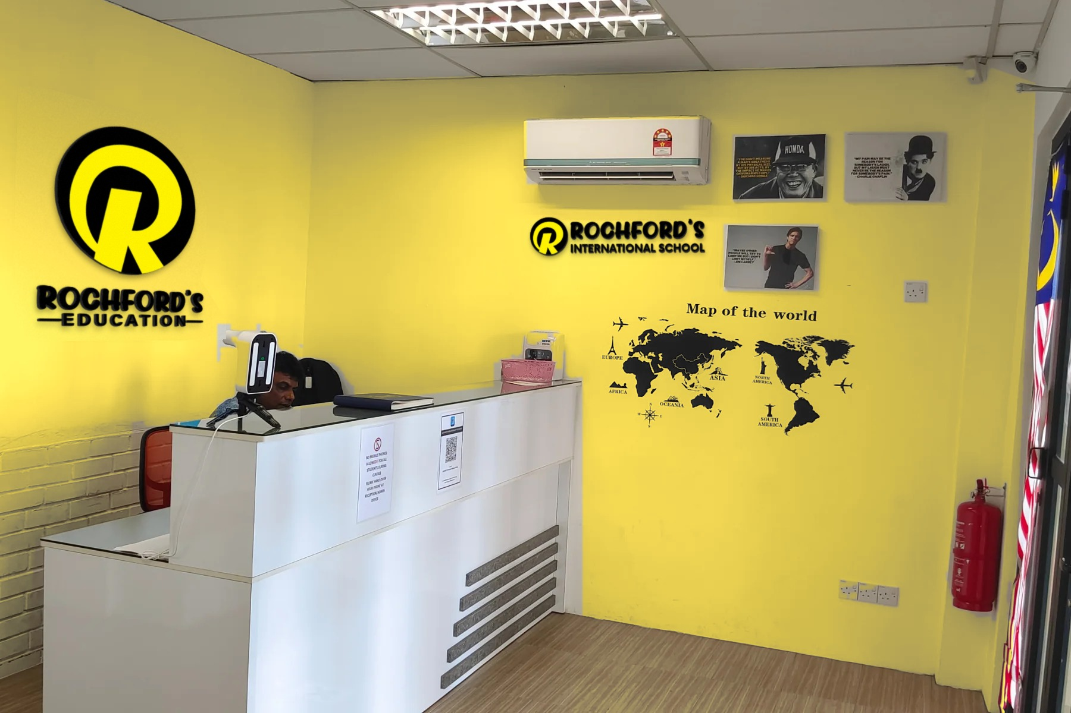
Rochford’s International School
WHO WE ARE
A premium boutique school like no other, by Rochford’s Education.
Primary to Secondary
Year 1 to Year 11, through to IGCSE. We teach school years only, with no pre-school.
3 Campuses
✓
Falim, Ipoh Garden and Cameron Highlands, with Kuala Lumpur coming soon.
Parent Visit · Ipoh
Notes:
A premium boutique school like no other. Primary to secondary only (Year 1 to Year 11), no pre-school.
Campuses: Falim, Ipoh Garden and Cameron Highlands; Kuala Lumpur coming soon.
Sources: our founder; https://edquest.edu.my/pages/about-us

Slide 3
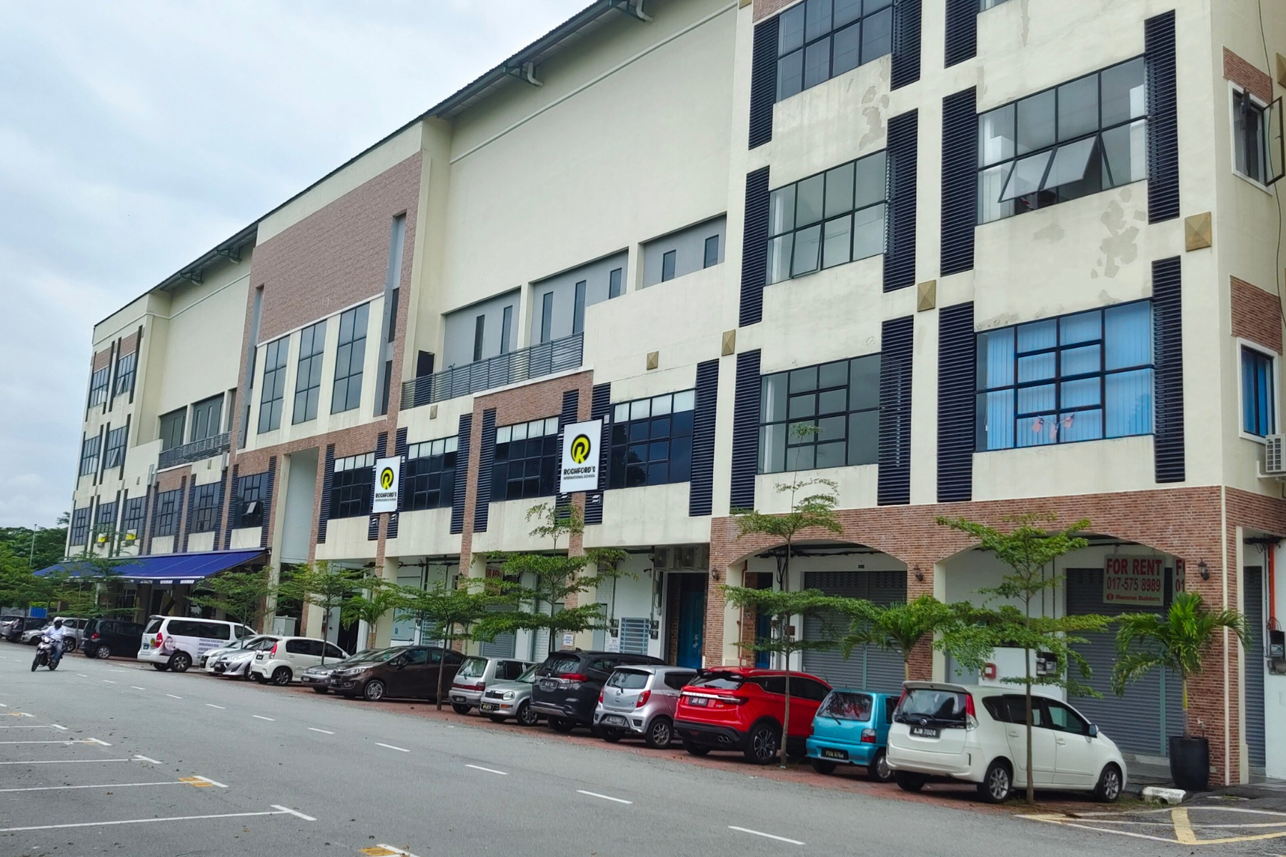
Rochford’s International School
WHY PARENTS TRUST US
We are an approved IGCSE international school, part of Rochford’s Education Group, a Ministry of Education licensed school group.
2020
Pearson Excellence Award
2
Dual IGCSE pathways
Recognition from Pearson, one of the world’s leading exam boards.
Pearson Edexcel and OxfordAQA, graded 9–1.
Pearson award
Boards
Parent Visit · Ipoh
Notes:
Approved IGCSE international school; Pearson Excellence Award 2020; dual Pearson Edexcel and OxfordAQA IGCSE.
Sources: https://edquest.edu.my/pages/about-us ; https://edquest.edu.my/pages/igcse ; https://edquest.edu.my/pages/pearson-excellence-award

Slide 4
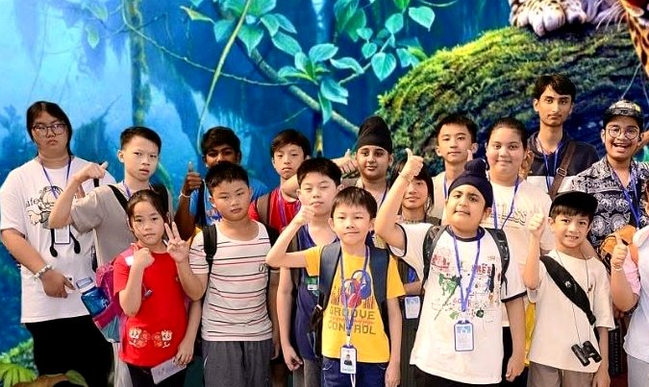
Rochford’s International School
PRIMARY
YEARS
Year 1 to Year 5
A British-style international pathway from Year 1. Teaching is modular and mastery-based: children progress module by module, building genuine understanding.
Taught in English
Placed by readiness
✓
All lessons, every subject
✓
Competency, not age
English support
Mastery-based
✓
Alongside their subjects
✓
Understand, then move on
Parent Visit · Ipoh
Notes:
Primary: Year 1 to Year 5. British-style international pathway from Year 1; modular and mastery-based; placed by competency and readiness; all lessons in English with English support.
Sources: https://edquest.edu.my/pages/about-us ; https://edquest.edu.my/pages/faq ; https://edquest.edu.my/pages/addmission-page

Slide 5
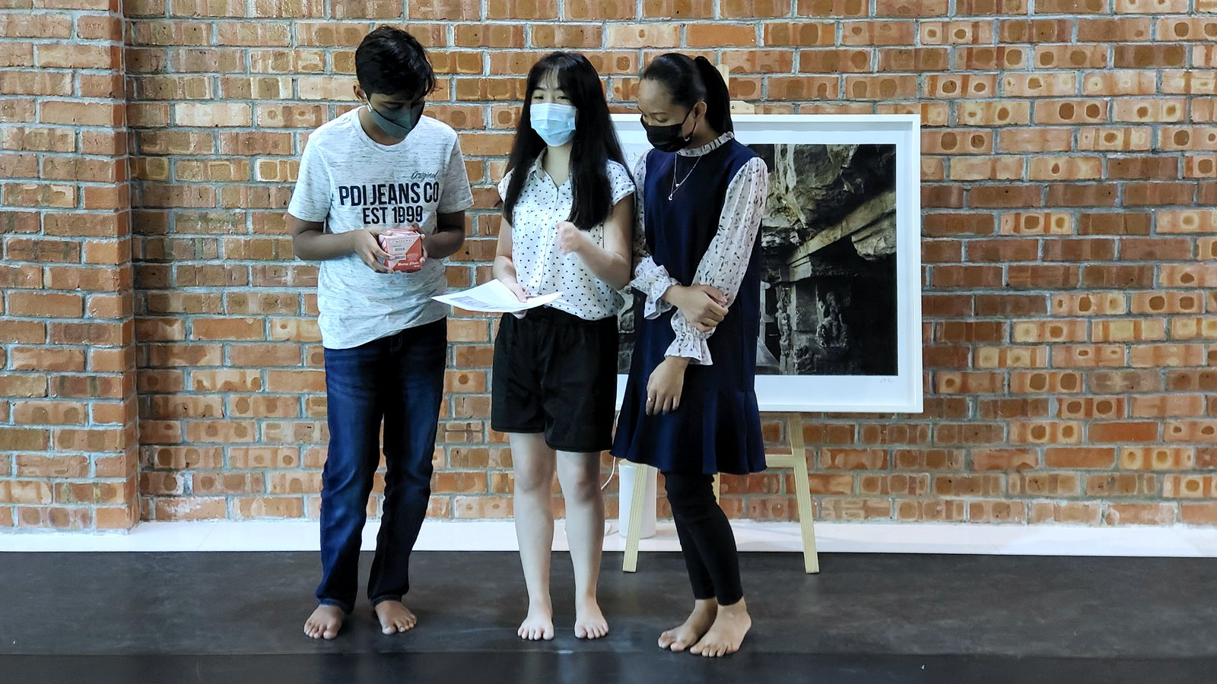
Rochford’s International School
LOWER
SECONDARY
Year 6 to Year 8. Students keep building module by module, placed by readiness rather than age, as they move towards IGCSE examinations at Year 9 to 11.
Ready early?
Start any time
Our youngest IGCSE candidates have sat exams at just 13.
Enrolment is ongoing, so a child can start a new module at any time.
Parent Visit · Ipoh
Notes:
Lower secondary: Year 6 to Year 8 (fee band Year 6-8); IGCSE examinations at Year 9-11; modular, placed by readiness; youngest IGCSE candidates sat exams at 13; ongoing enrolment.
Sources: https://edquest.edu.my/pages/faq ; https://edquest.edu.my/pages/addmission-page ; https://edquest.edu.my/pages/about-us

Slide 6
01
Rochford’s International School
Pearson Edexcel
IGCSE: TWO
LEADING UK BOARDS
Most of our subjects. Many can be taken in a modular route, with units sat across different exam sessions.
Secondary students work towards International GCSEs at Year 9 to 11, graded 9 (highest) to 1, the same scale as GCSEs in England.
02
OxfordAQA
Psychology, Sociology and Media Studies. A partnership of Oxford University Press and AQA.
17
IGCSE subjects on offer
Parent Visit · Ipoh
Notes:
IGCSE at Year 9-11; Pearson Edexcel (most subjects, modular route available) and OxfordAQA (Psychology, Sociology, Media Studies); graded 9-1; 17 IGCSE subjects offered (Malay via Cambridge).
Sources: https://edquest.edu.my/pages/igcse ; https://edquest.edu.my/pages/faq ; https://edquest.edu.my/pages/about-us

Slide 7
17 IGCSE subjects
SUBJECTS WE OFFER
Pearson Edexcel
Pearson Edexcel
OxfordAQA
English First Language
English as a Second Language
Chinese (Mandarin)
Mathematics
Further Pure Mathematics
Biology
Chemistry
Physics
Human Biology
Global Citizenship
Business
Commerce
ICT
Psychology
Sociology
Media Studies
Cambridge IGCSE
Malay (Foreign Language)
Parent Visit · Ipoh
Some subjects run subject to demand. Please check availability with our admissions team.
Notes:
17 IGCSE subjects. Pearson Edexcel (13): English First Language (English Language A), English as a Second Language, Chinese (Mandarin), Mathematics A, Further Pure Mathematics, Biology, Chemistry, Physics, Human Biology, Global Citizenship, Business, Commerce, ICT. OxfordAQA (3): Psychology, Sociology, Media Studies. Cambridge (1): Malay - Foreign Language (0546). Some subjects run subject to demand.
Source: https://edquest.edu.my/pages/igcse-subjects ; https://edquest.edu.my/pages/igcse

Slide 8
Career-Entry Programme
LAW SCHOOL
PATHWAY
After IGCSE: Cambridge International AS & A Levels in Law, Psychology and Business. Then a law degree at a local or international university, or the University of London LLB with our teaching and support.
Parent Visit · Ipoh
Notes:
Law School career-entry programme: IGCSE foundations, then three Cambridge International AS & A Levels (Law, Psychology, Business), then Route A (local or international university) or Route B (University of London LLB with our teaching and support), then an LLB and a legal career.
Source: https://edquest.edu.my/pages/law-school

Slide 9
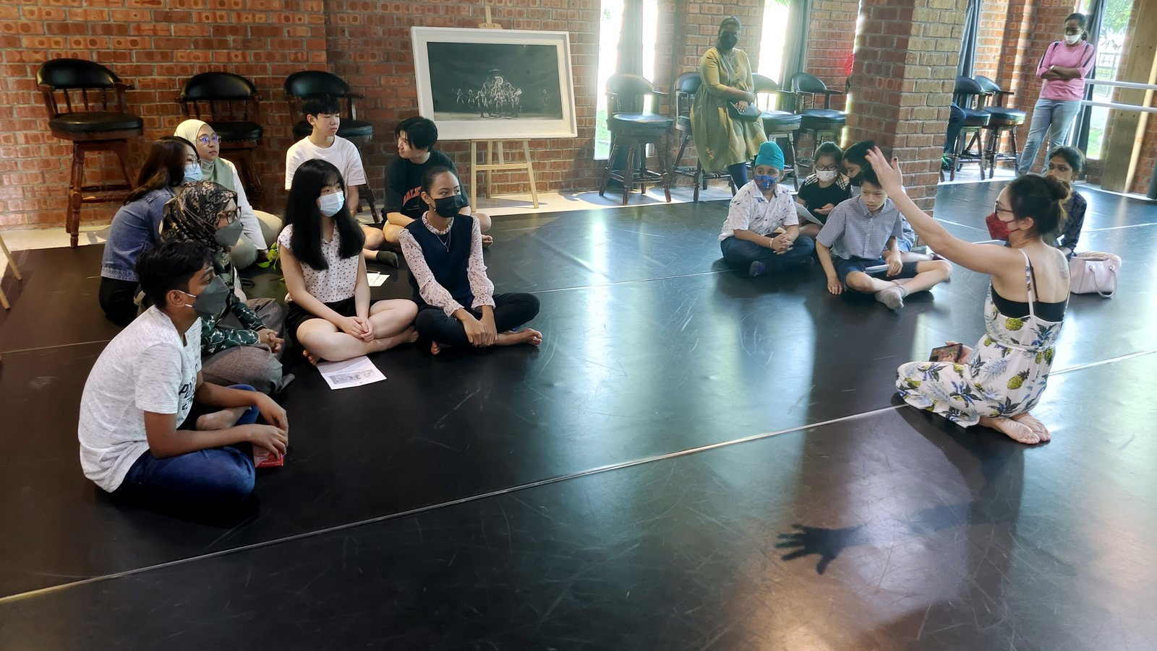
Rochford’s International School
RISE CENTRE,
COMING SOON
A dedicated space to support learners with special educational needs alongside an international education. We start with your child, not a label, and you do not need a formal diagnosis to talk to us.
An individual learning plan, small-group and one-to-one support, learning alongside mainstream classes, and regular parent updates.
Parent Visit · Ipoh
Notes:
RISE Centre (coming soon): support for learners with special educational needs alongside an international education; no formal diagnosis needed; individual learning plan; small-group and one-to-one support; learning alongside mainstream classes; regular parent updates.
Photo: dance studio visit (illustrative, not a RISE session).
Source: https://edquest.edu.my/pages/rise-centre

Slide 10
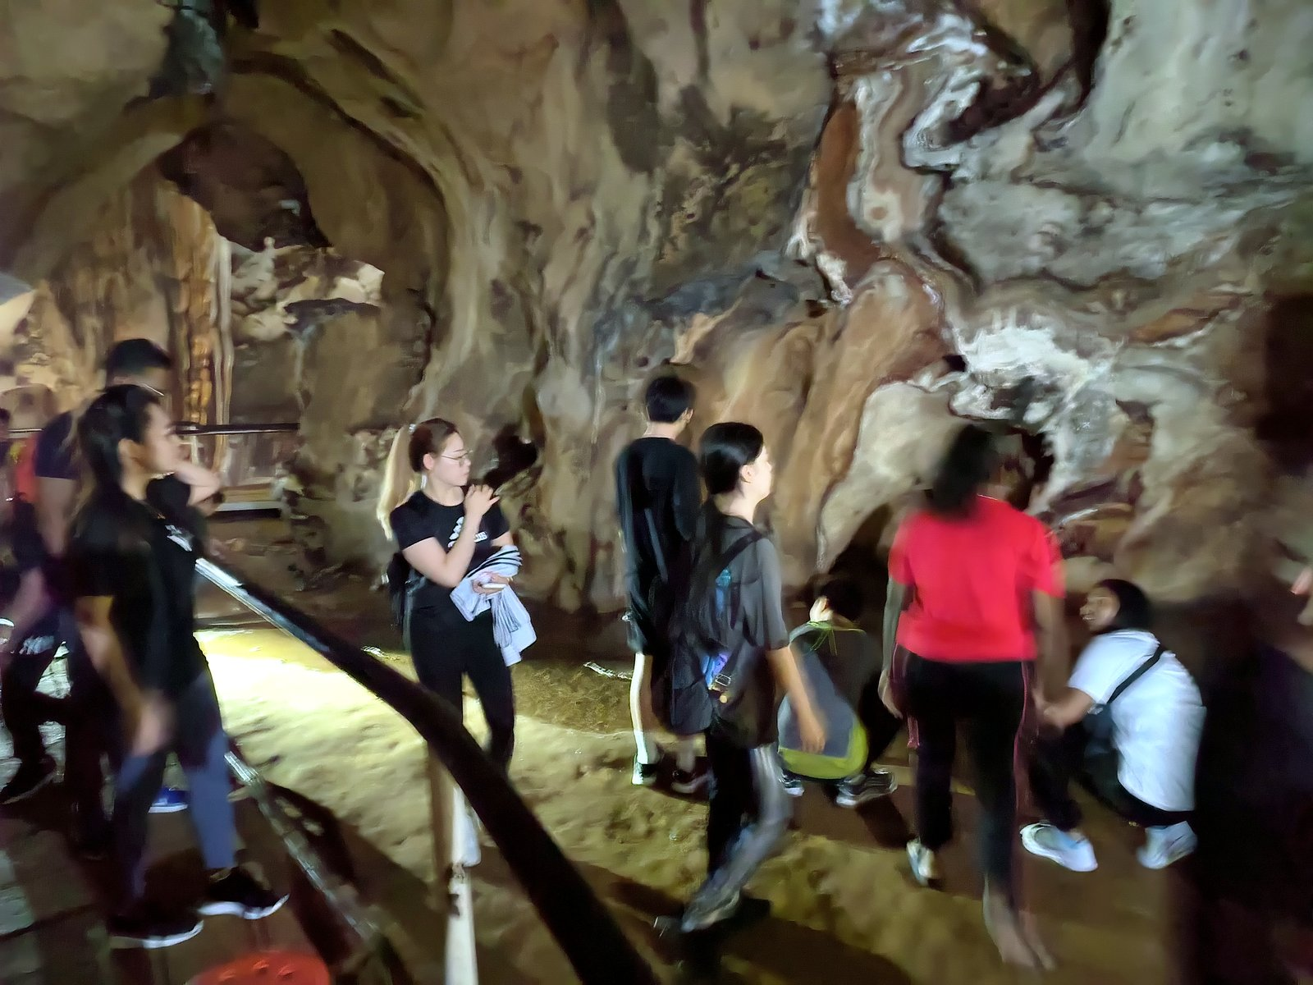

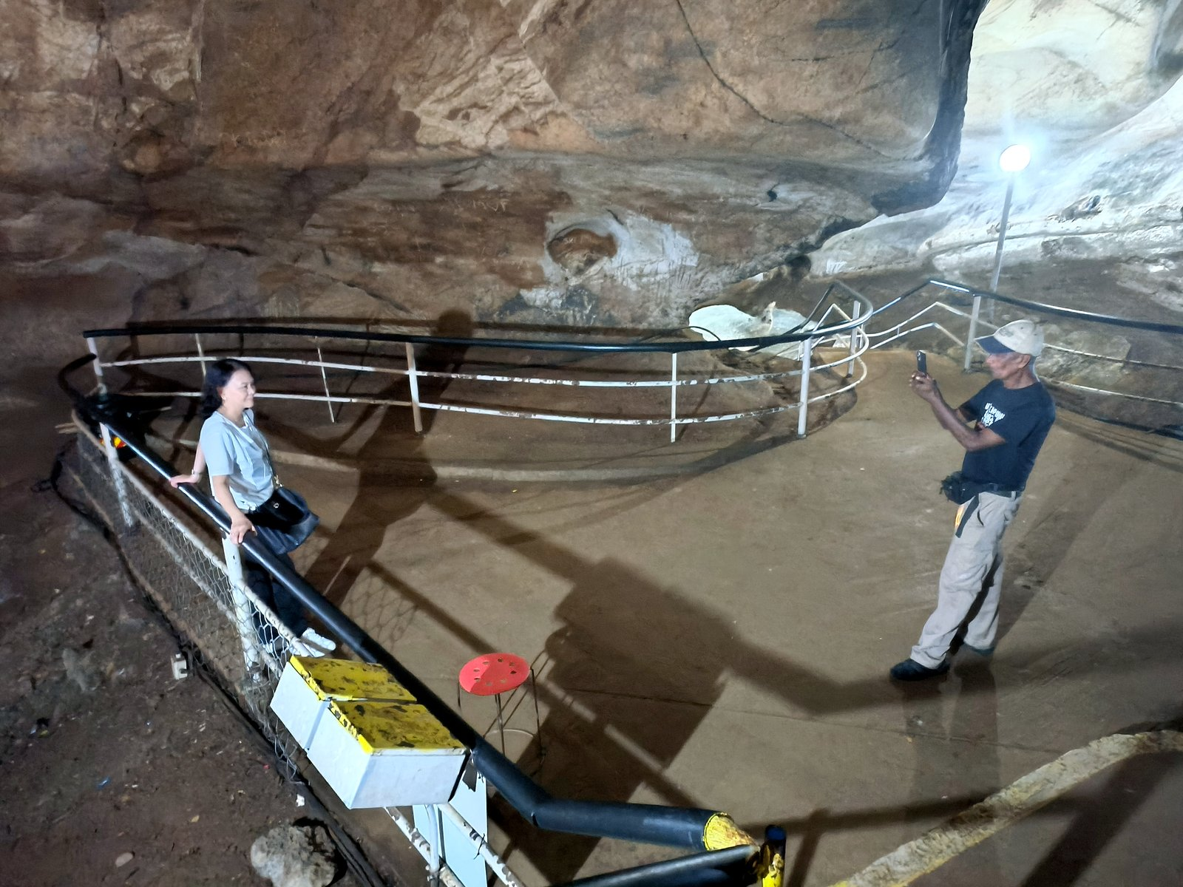
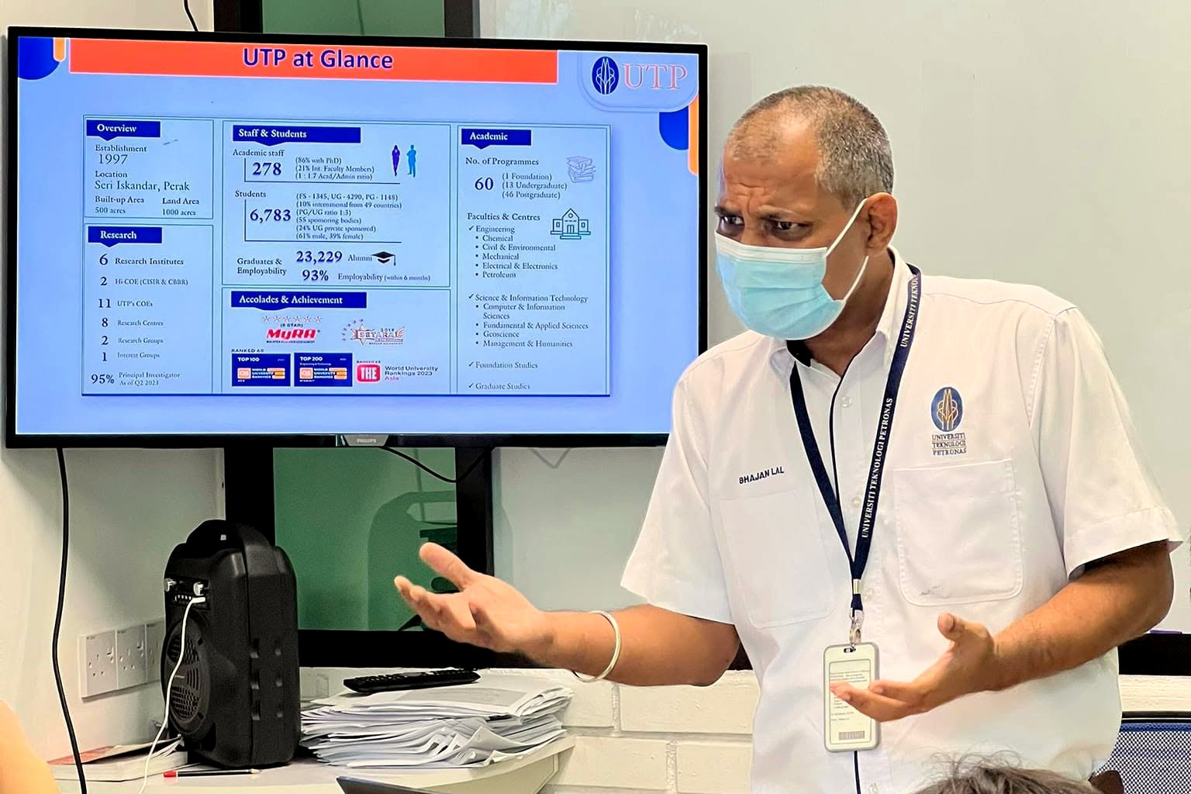
School life
Beyond the Classroom
Family Day Bowling Tournament
Gua Tempurung cave trip
Trips to Gua Tempurung, Taiping Zoo, Papan and Qing Xin Ling, our Family Day Bowling Tournament, guest talks, and a sister school programme with Global Islamic School, Indonesia.
A photo stop inside Gua Tempurung
Guest talk: beating procrastination
Parent Visit · Ipoh
Notes:
Beyond the classroom: Gua Tempurung trip (20 April 2023), Family Day Bowling Tournament (4 October 2025), Taiping Zoo and Telegraph Museum trip, Papan heritage trip, Qing Xin Ling field trip, guest talk on overcoming procrastination (21 March 2024), sister school programme with Global Islamic School, Indonesia (from August 2026).
Source: https://edquest.edu.my/pages/school-activities

Slide 11
Our students. Their achievements.
HALL OF
EXCELLENCE
Grade 9
Chai Jia Wern
Grade 9 in IGCSE Mandarin and Grade 8 in IGCSE Malay.
Gyanveer Singh Auluck
National Champion, Men’s Raw Junior 93 kg, National Powerlifting Championships 2024.
Lee De Xuan
Grade 8
IGCSE Malay and Mandarin, after sitting his IGCSEs at 13.
Chuah Yu Xiang
IGCSE Mandarin, at just 14 years old.
Notes:
Hall of Excellence: Lee De Xuan, Grade 9 in IGCSE Malay and IGCSE Mandarin, sat IGCSEs at 13. Chuah Yu Xiang, Grade 8 in IGCSE Mandarin at 14. Chai Jia Wern, Grade 9 in IGCSE Mandarin and Grade 8 in IGCSE Malay (website wording, approved). Gyanveer Singh Auluck, National Champion, Men's Raw Junior 93 kg, National Powerlifting Championships 2024.
Sources: https://edquest.edu.my/pages/hall-of-excellence ; our founder (23 and 26 Oct 2026)

Slide 12
Simple. Transparent. Affordable.
OUR FEES
We run a 4-term academic year, with fees charged per term to give families maximum financial flexibility.
RM 3,400
RM 3,900
RM 4,900
Year 1 to Year 5
Year 6 to Year 8
Year 9 to Year 11 · IGCSE
Per term. RM 13,600 per year (4 terms).
Per term. RM 15,600 per year (4 terms).
Per term. RM 19,600 per year (4 terms).
Parent Visit · Ipoh
Fees as published on our website; please check with admissions for the latest.
Fees do not include books, uniforms, transportation, food, co-curricular activities, educational visits, external examination fees or applicable government taxes.
Notes:
Our fees (school's own only): Year 1-5 RM 3,400 per term (RM 13,600 per year, 4 terms); Year 6-8 RM 3,900 per term (RM 15,600 per year); Year 9-11 IGCSE RM 4,900 per term (RM 19,600 per year). Exclusions as listed. The page also offers an Academic Merit Scholarship (up to 30% fee reduction) and a Financial Assistance Bursary.
Source: https://edquest.edu.my/pages/fees

Slide 13
Admissions
HOW TO JOIN
Free consultation
No obligation, no pressure. In person or online, 45–60 minutes. Bring your questions.
Joining is straightforward and supportive. We guide every family from the first enquiry to the first day in class.
01. Enquire & consult
02. Friendly assessment
03. Offer, enrol & welcome
Get in touch by WhatsApp, phone, email or walk in. Then a free, no-obligation consultation, in person or online.
A short diagnostic, not a high-stakes exam. Results and a personalised programme recommendation within 2–3 days.
A clear written offer with full fees, then registration and orientation.
WhatsApp our admissions team:
010-253 9817
Notes:
How to join, condensed from the six admissions steps (Enquire, Consultation, Assessment, Offer, Enrol, Welcome): 1) enquire by WhatsApp, phone, email or walk-in, then a free no-obligation consultation (in person or online, 45-60 minutes); 2) friendly diagnostic assessment, results and programme recommendation in 2-3 days; 3) written offer with full fees, registration, orientation. WhatsApp 010-253 9817.
Source: https://edquest.edu.my/pages/addmission-page

Slide 14
THANK YOU
for visiting
WhatsApp 010-253 9817
Falim · Ipoh Garden · Cameron Highlands
Kuala Lumpur (coming soon)
Parent Visit · Ipoh
Notes:
Thank you for visiting. WhatsApp our admissions team: 010-253 9817. Campuses: Falim, Ipoh Garden, Cameron Highlands; Kuala Lumpur coming soon.
Sources: our founder; https://edquest.edu.my/pages/addmission-page

